Slide 1


Slide 2
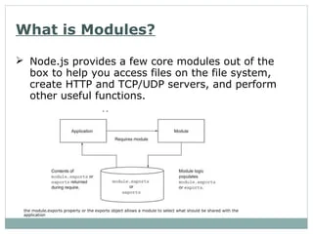

Slide 3
UNIT II
WHAT IS A MODULE
In JavaScript, a module is a file that contains code that can be imported into other code files. JavaScript modules are an integral aspect of modern web development
these modules serve as containers for encapsulated pieces of code, allowing developers to organize their projects efficiently.
Many standard Node modules are present i.e. File system, process access, networking, timers, devices, crypto, etc

Slide 4
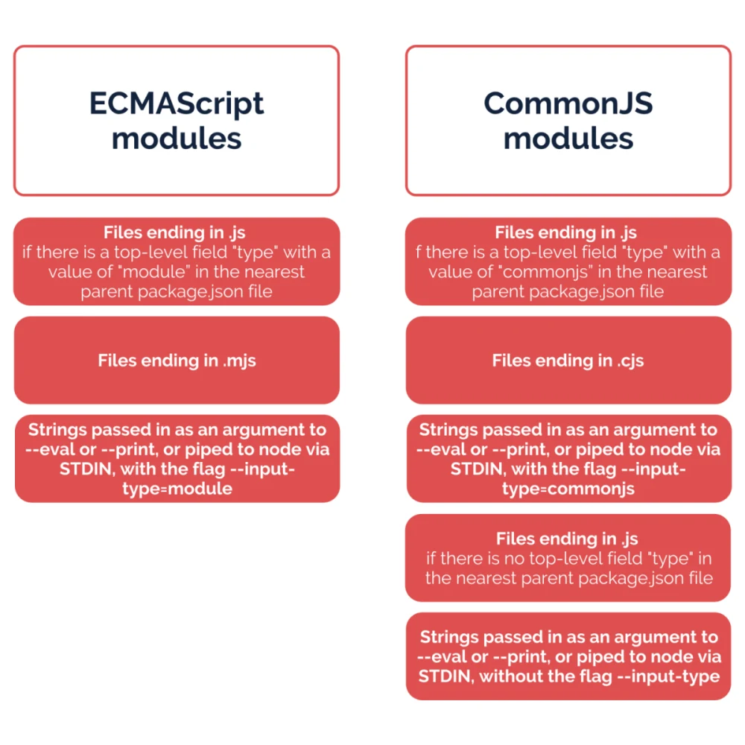

Slide 5
The import and export keywords serve as the bridge that connects different modules, enabling developers to harness the power of modular programming and build scalable solutions
The export keyword makes variables or functions available to other modules.
In contrast, The import keyword is utilized for importing variables or functions into other modules

Slide 6
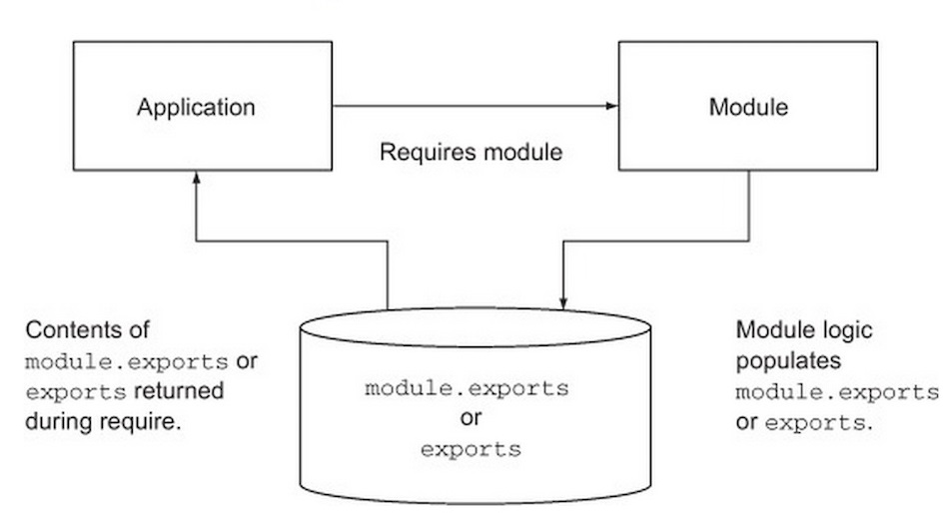

Slide 7


Slide 8


Slide 9
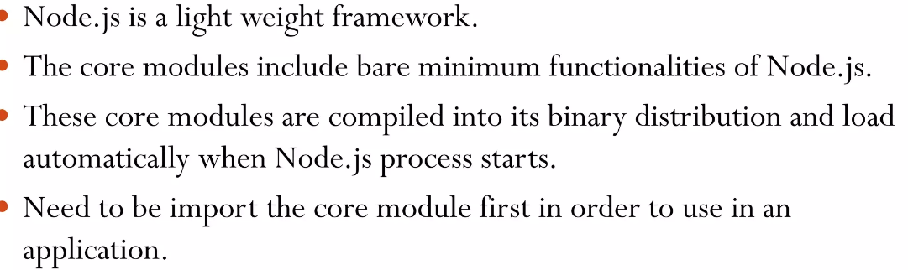
What is core module

Slide 10
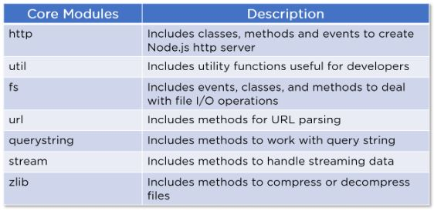

Slide 11
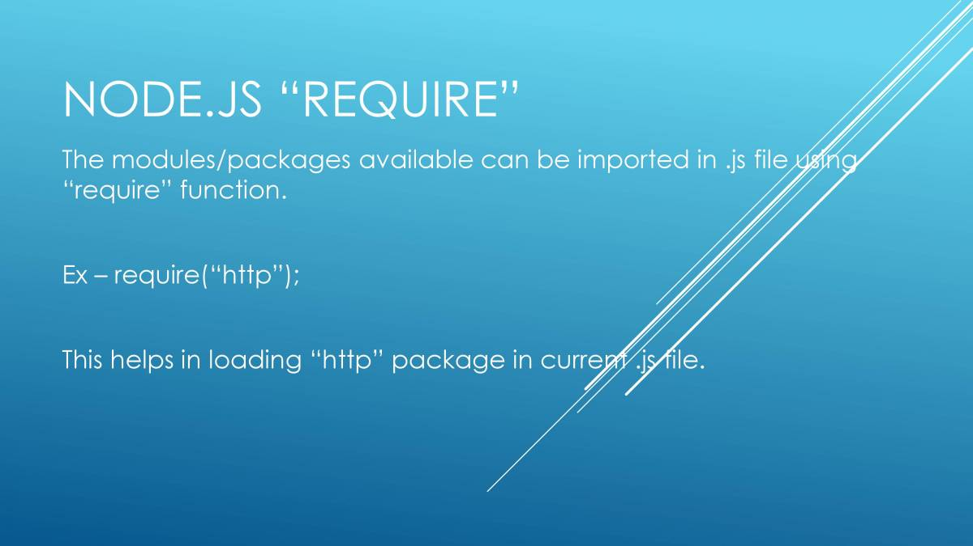

Slide 12

Local modules or custom modules

Slide 13
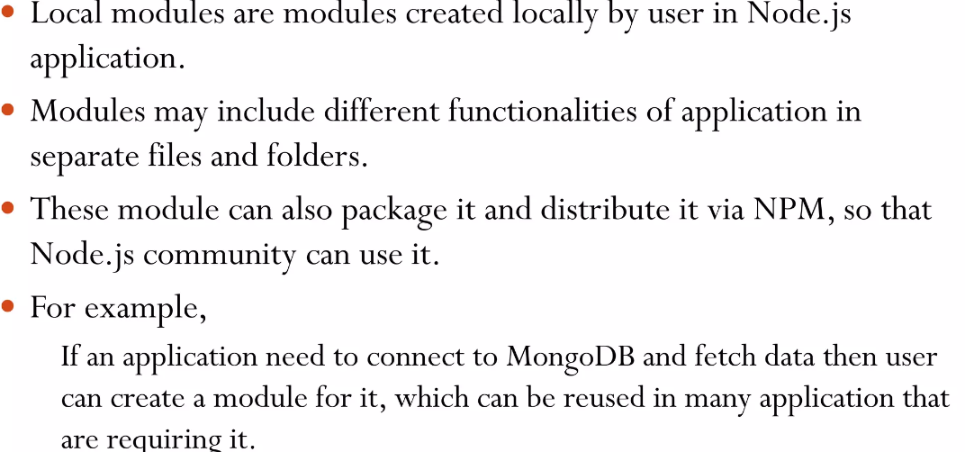
Local modules

Slide 14
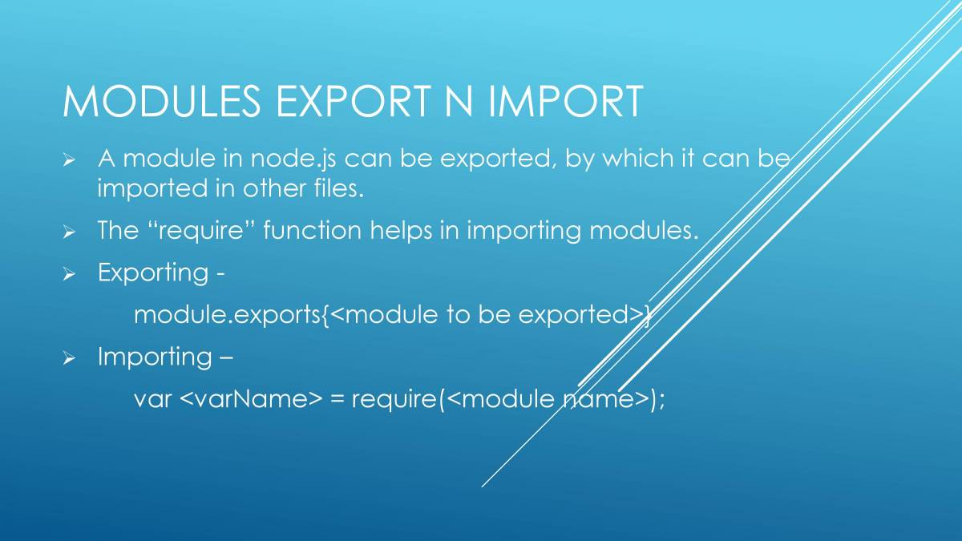

Slide 15
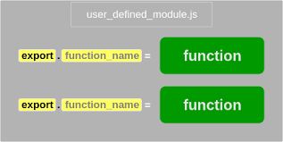
How it works

Slide 16
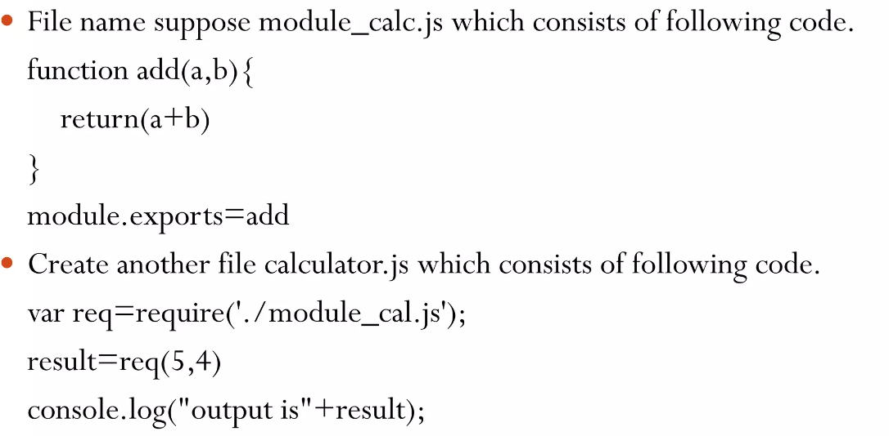
How can we create local module

Slide 17
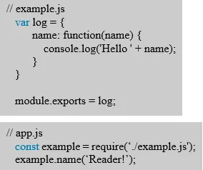
Example 2

Slide 18
We will discuss the third type of module i.e. Third party modules later on

Slide 19

Now it is time to focus on core modules first we will discuss about file module

Slide 20
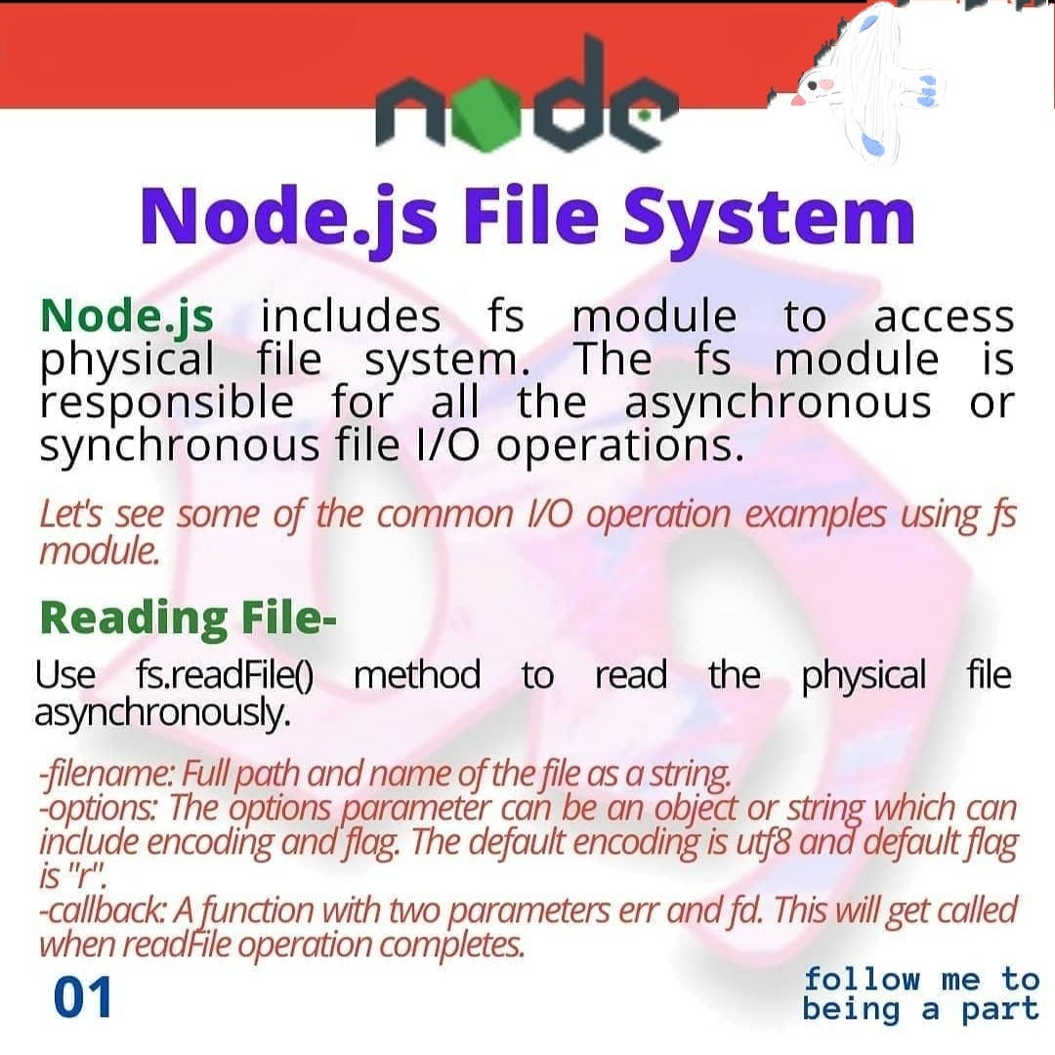

Slide 21
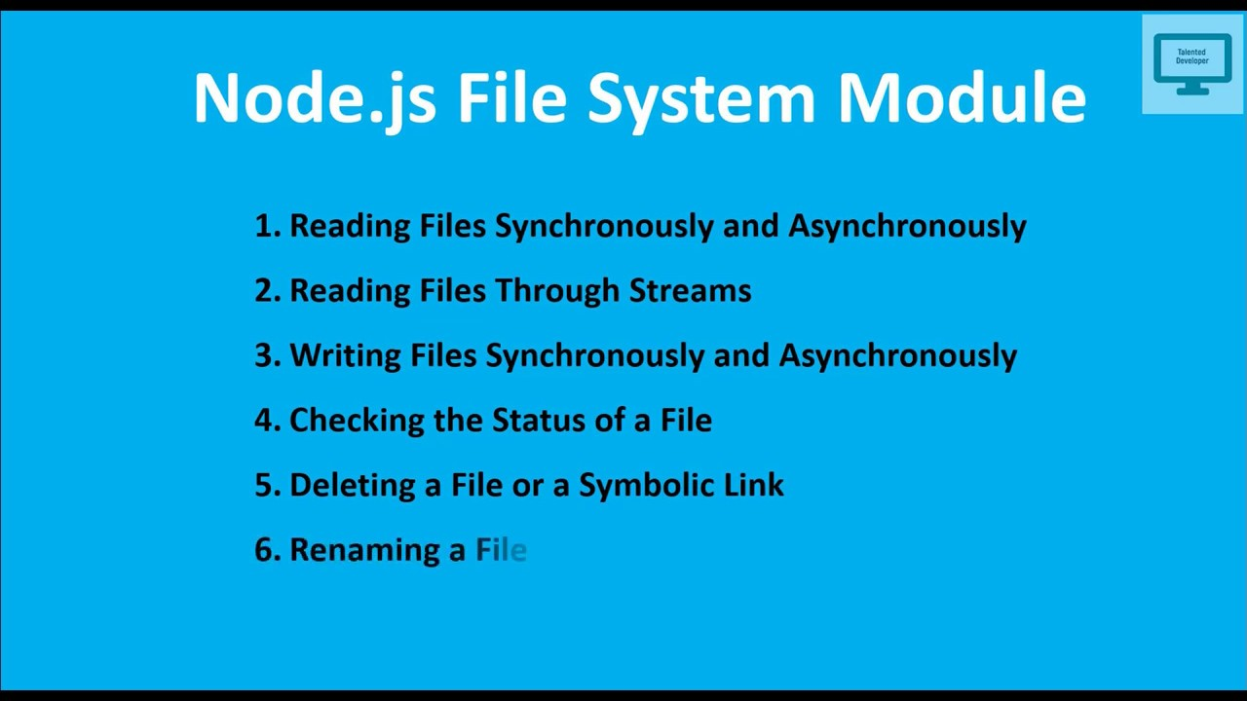

Slide 22
To read a file asynchronously
const fs = require('fs')
fs.readFile('myfile.txt', 'utf8', (err, data) => {
if (err) {
console.error('Error reading file:', err)
return
}
console.log('File content:', data)
})

Slide 23
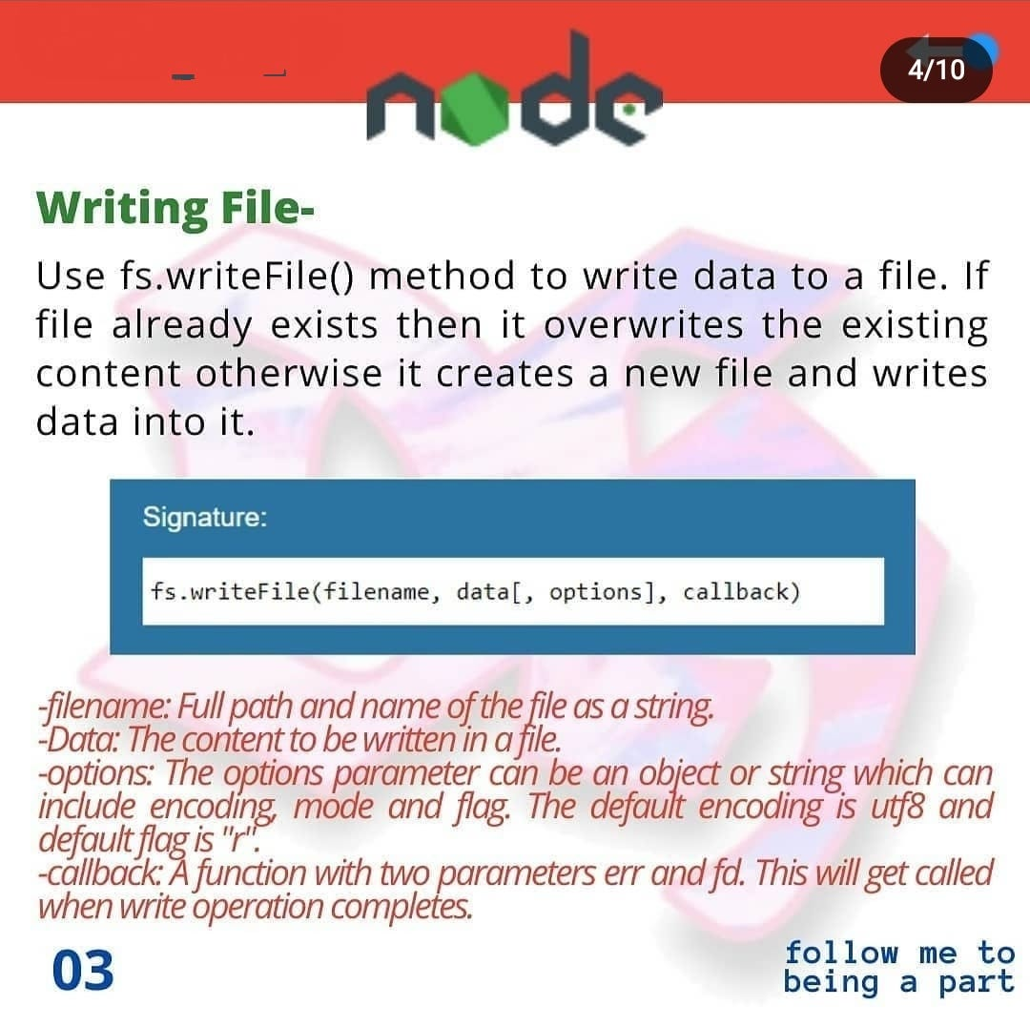

Slide 24
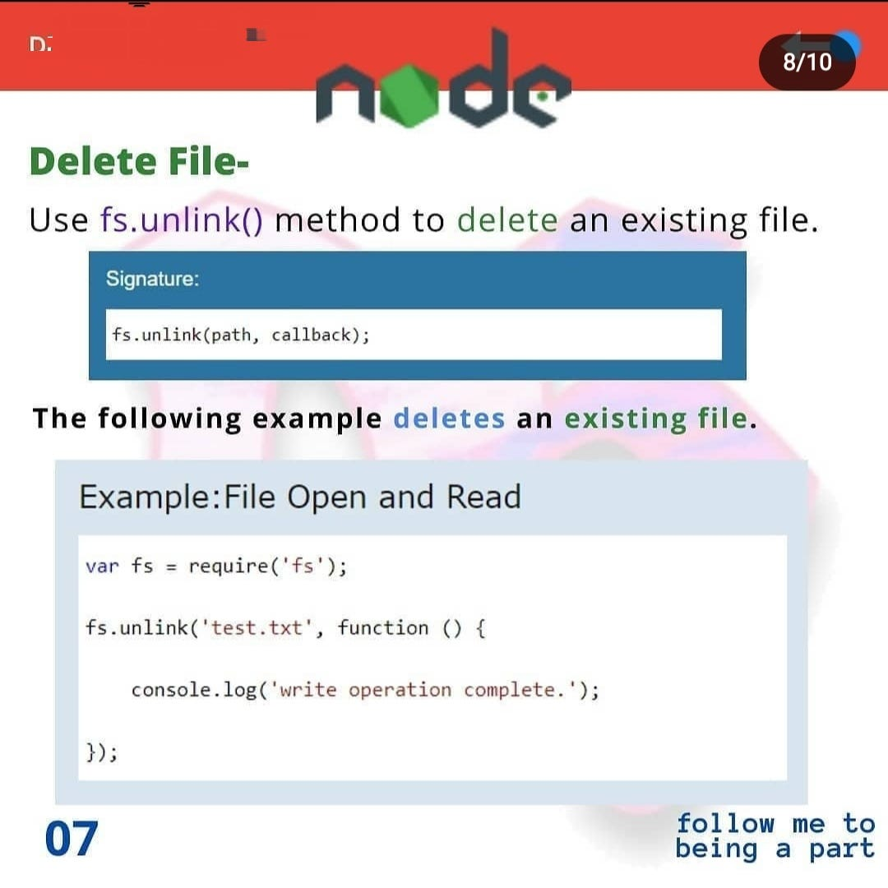

Slide 25
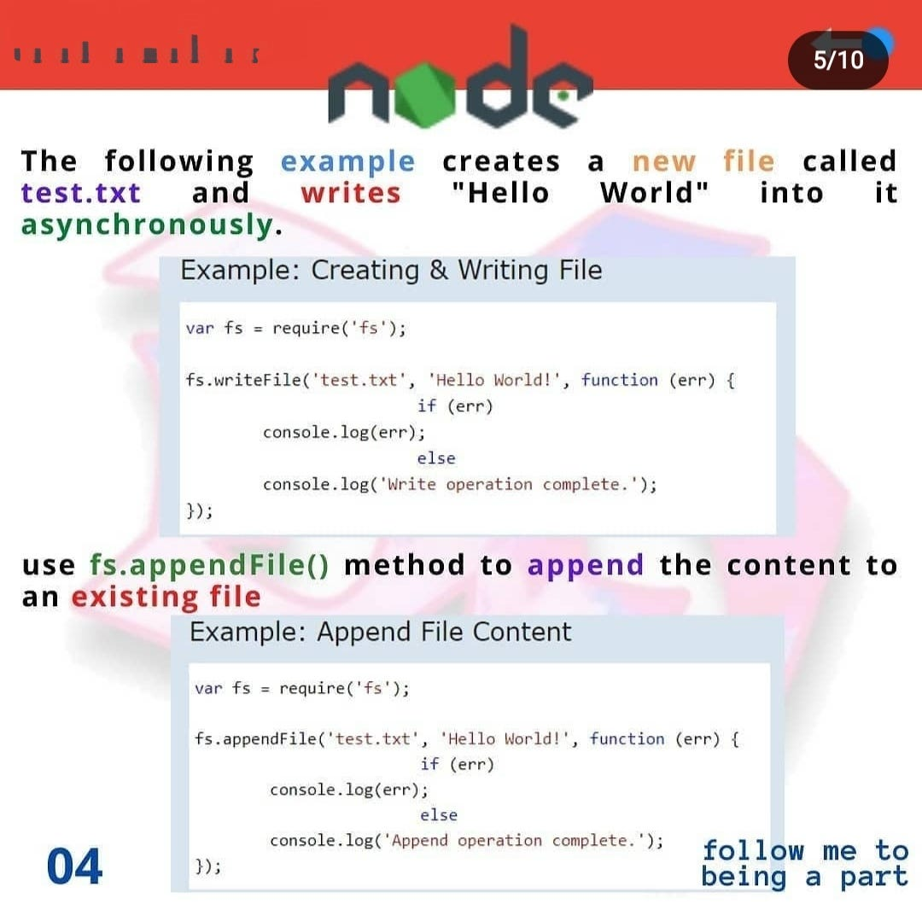

Slide 26
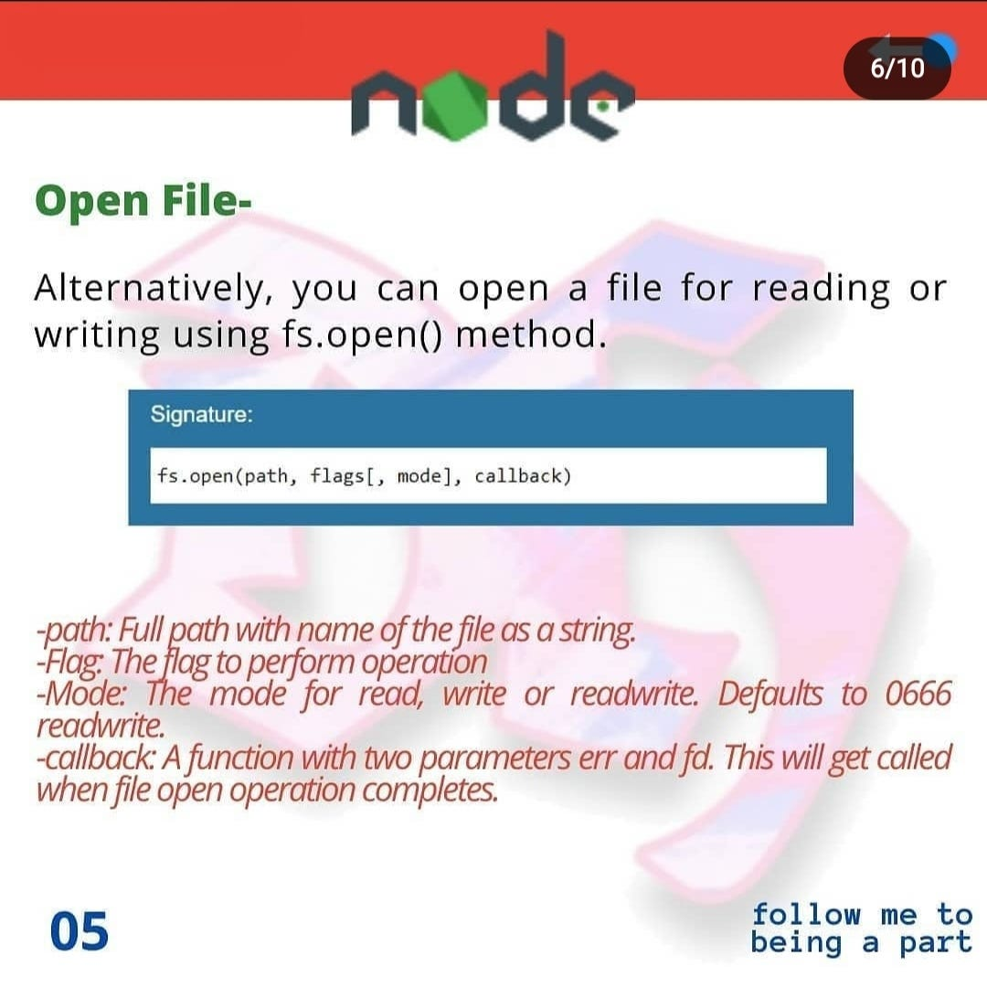

Slide 27
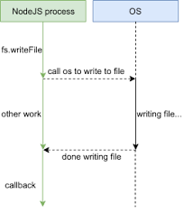
How asynchronous feature of node js works…..

Slide 28


Slide 29
Working with json files
JSON (JavaScript Object Notation) files are a common data interchange format used to store and exchange data between systems.
JSON is a lightweight, text-based format that is easy for humans to read and write, and easy for machines to parse and generate.
JSON files typically have a ".json" file extension.

Slide 30
JSON contd….
When you want to store data between server restarts with Node, JSON files are a simple and convenient choice.
JSON is perfect for storing temporary data. For example, temporary data can be user-generated data, such as a submitted form on a website.
Whether you are reading a config file or persisting data for your application, Node has some built in utilities that make it easy to read and write JSON files

Slide 31
Usage of JSON files:
Configuration Files: Storing configuration settings for applications in a structured format.
Data Exchange: Sending data between a server and a client in web development (commonly used in AJAX requests)
APIs (Application Programming Interfaces): Many APIs use JSON as the data format for communication between different software system
Persistence: Storing structured data in a flat-file format

Slide 32
Creation of JSON
Objects are wrapped within '{' and '}'. Arrays are enclosed by '[' and ']’.
Objects are a list of label-value pairs.
Arrays are list of values.

Slide 33
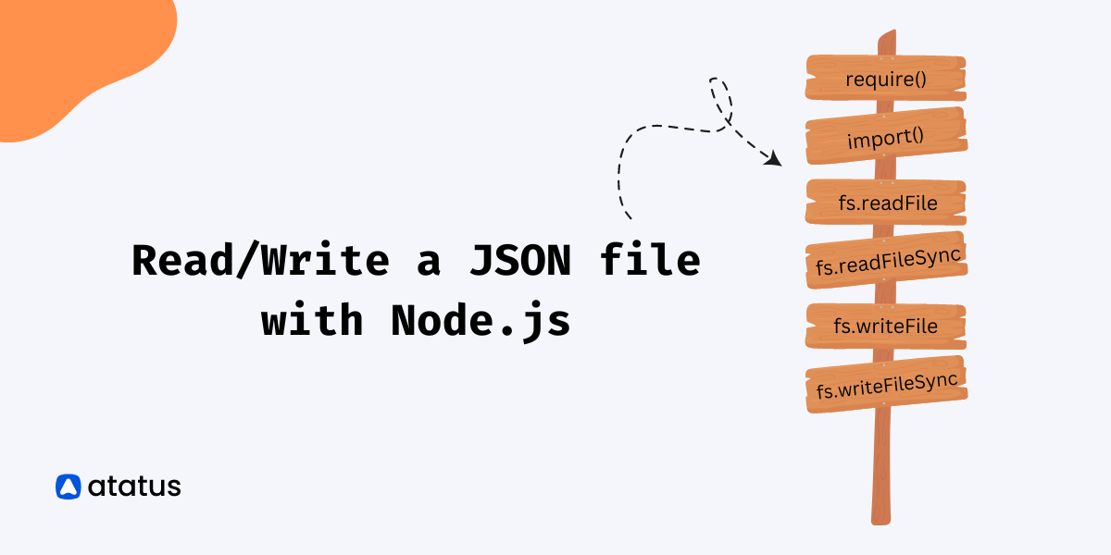

Slide 34
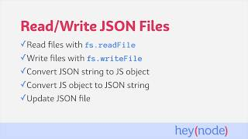

Slide 35
Reading the JSON file
JavaScript provides 2 methods for encoding data structures to json and encoding json back to JavaScript objects and arrays.
JSON.parse takes a JSON string and decodes it to a JavaScript data structure.
The JSON.parse() method parses a JSON string, constructing the JavaScript value or object described by the string

Slide 36
Writing into JSON
We use JSON.stringfy() to write something in json file
The JSON.stringify() method converts a JavaScript object or value to a JSON string, optionally replacing values if a replacer function is specified or optionally including only the specified properties if a replacer array is specified.
JSON.stringify(value[, replacer[, space]])

Slide 37
Serializing and deserializing JSON
The Node runtime environment has the built-in fs module specifically for working with files.
Serialization is the process of modifying an object or data structure to a format that is easy to store or transfer over the internet
syntax:
console.log(JSON.stringify(name of the file));

Slide 38
Deserialization refers to transforming the serialized data structure to its original format.
JavaScript object using the JSON.parse method before accessing or manipulating the data
console.log(JSON.parse(name of json file));

Slide 39
Appending a JSON file const { writeFile, readFile } = require('fs’); const path = './config.json’; readFile(path, (error, data) => { if (error) { console.log(error); return; } const parsedData = JSON.parse(data); parsedData.createdAt = new Date().toISOString(); writeFile(path, JSON.stringify(parsedData, null, 2), (err) => { if (err) { console.log('Failed to write updated data to file’); return; } console.log('Updated file successfully’); }); });

Slide 40


Slide 41
Buffer module
A buffer is a way to store and manipulate binary data in Node. js.
Binary data refers to data that consists of binary values, as opposed to text data, which consists of characters and symbols.
Examples of binary data include images, audio and video files, and raw data from a network.

Slide 42
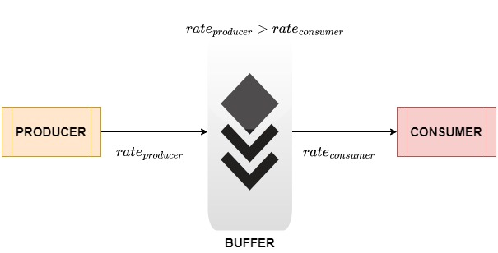

Slide 43


Slide 44
Working with Buffer module
in JavaScript, the "buffer" module is often associated with Node.js, and it provides a way to work with binary data directly.
The Buffer module is a global object that provides a way to work with binary data directly without having to write custom data parsing functions.

Slide 45
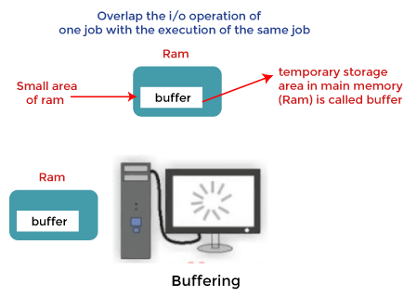
buffer is a space in computer memory, usually RAM, that stores binaries.

Slide 46
A binary stream is a collection of large amounts of binary data. Due to their massive size, binary streams are not sent together. Instead, they are broken into smaller pieces before sending.
When the data processing unit cannot accept any more data streams, excess data is stored in a buffer until the data processing unit is ready to receive more data.

Slide 47
When sending data to a receiver, it must be stored somewhere until the receiver can process it.
The Node.js buffer class is built for this purpose. It can handle and store binary data outside of the V8 engine, making it an efficient way to store and transfer data..

Slide 48
Accessing and Manipulating Data:
Buffers allow you to access and manipulate individual bytes of data. You can read and write data at specific offsets within the buffer

Slide 49
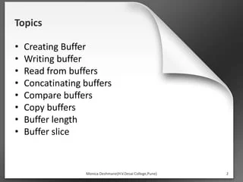

Slide 50
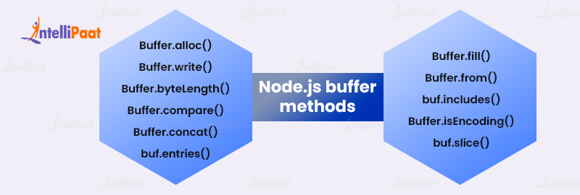
We will use the following functions

Slide 51
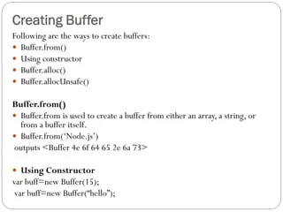
Creation of Buffers

Slide 52
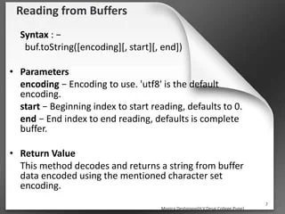

Slide 53
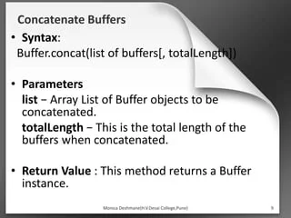

Slide 54
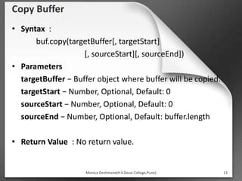

Slide 55
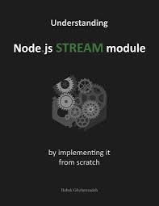

Slide 56
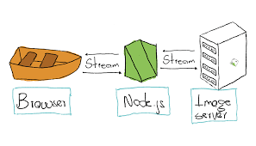
Working with streams

Slide 57
Stream Module
Streams are one of the fundamental concepts of Node.js.
Streams are used to handle reading/writing files or exchanging information in an efficient way
Streams are a type of data-handling method and are used to read or write input into output sequentially.

Slide 58
Examples of the stream object in Node.js can be a request to an HTTP server
Streams are objects in Node.js that lets the user read data from a source or write data to a destination in a continuous manner
What makes streams powerful while dealing with large amounts of data is that instead of reading a file into memory all at once, streams actually read chunks of data, processing its content data without keeping it all in memory

Slide 59
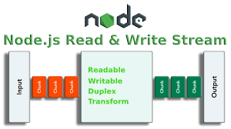

Slide 60
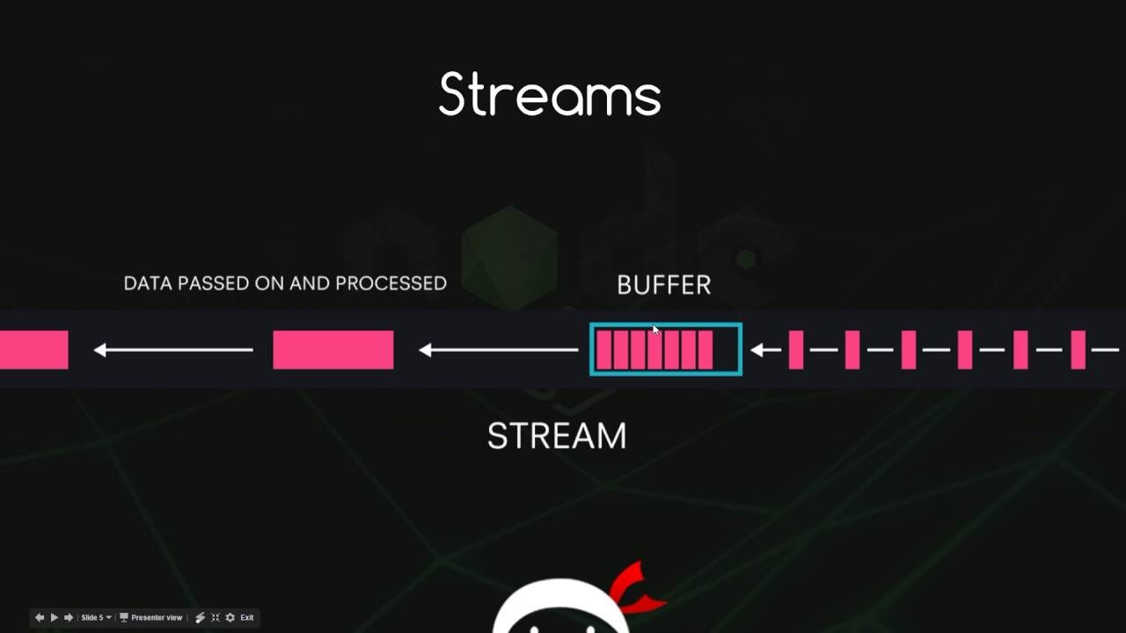
Difference between stream and buffer

Slide 61
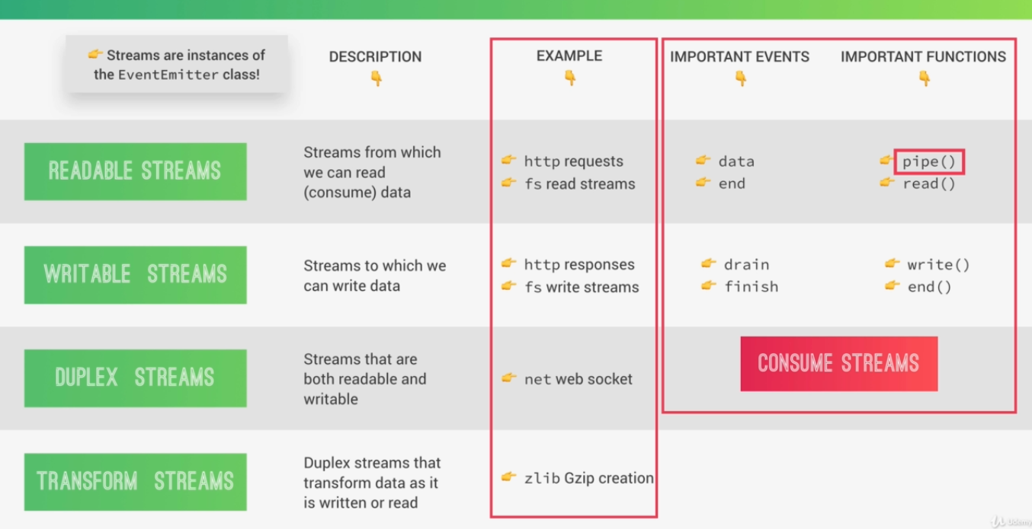
Types of streams

Slide 62
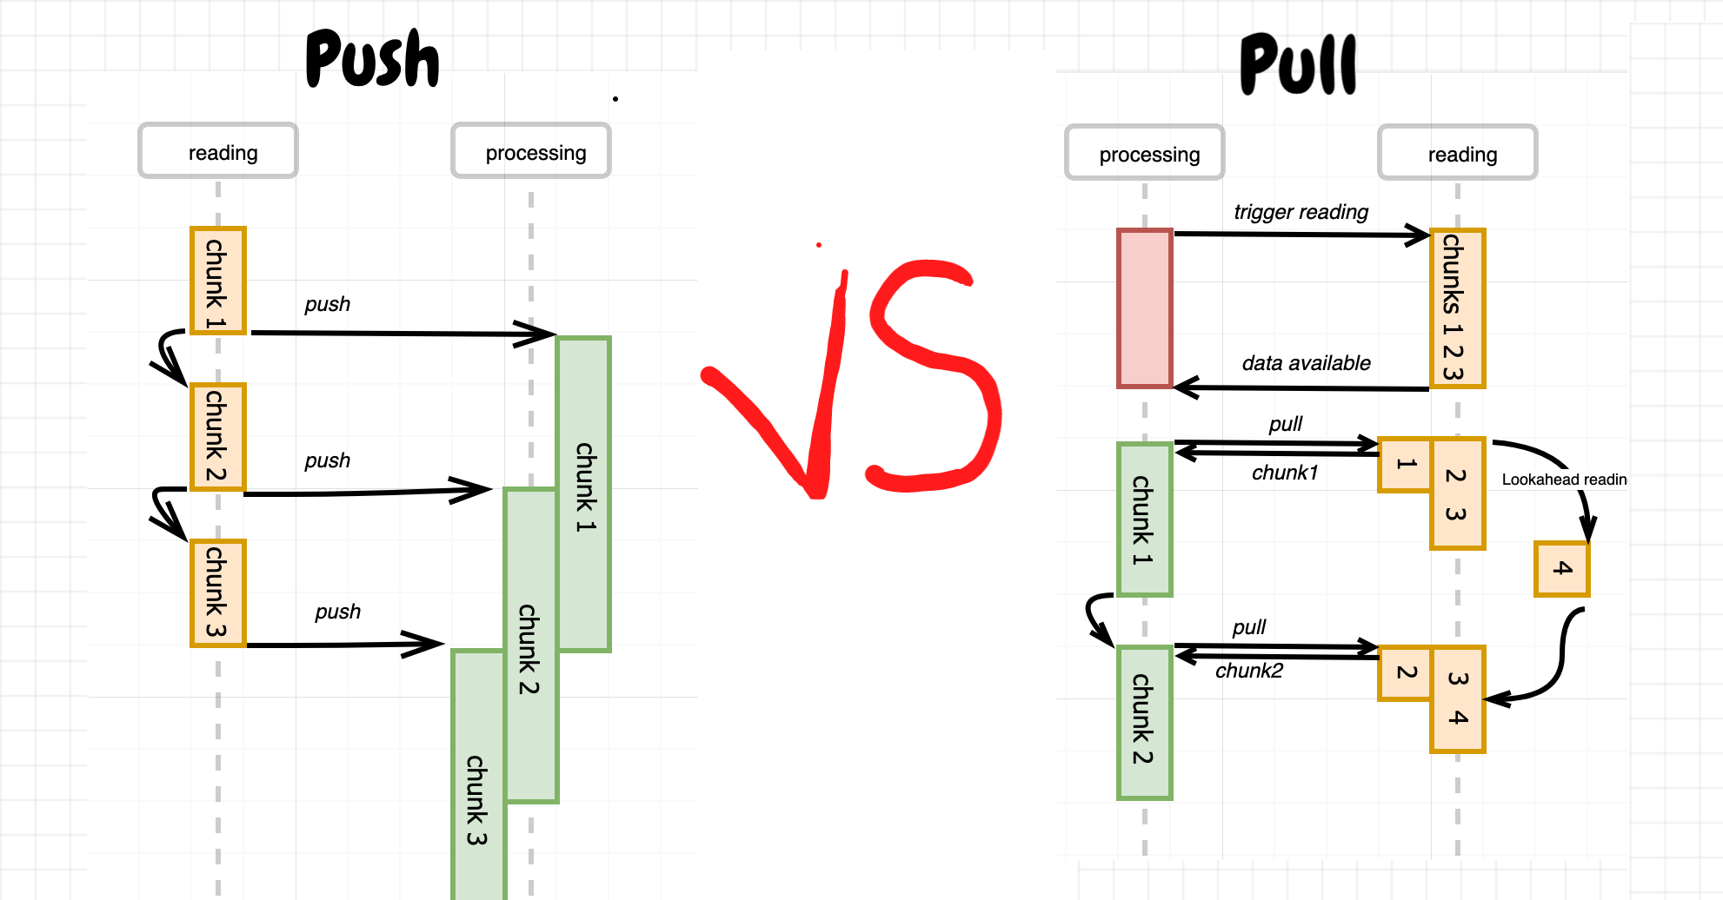
Writing and reading a stream

Slide 63
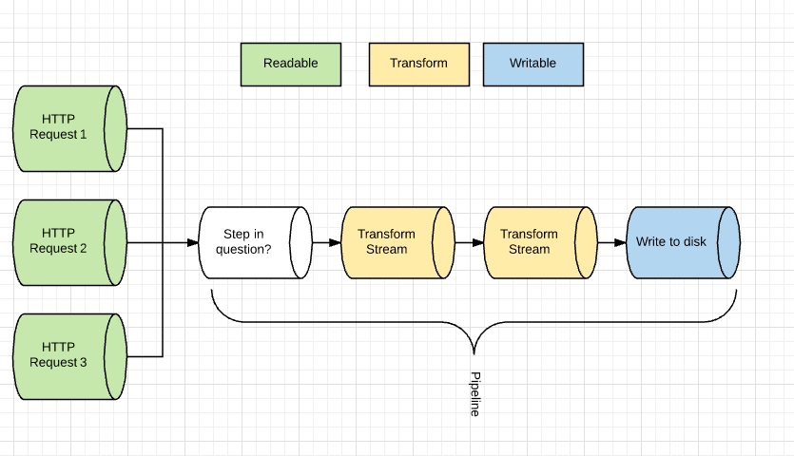

Slide 64
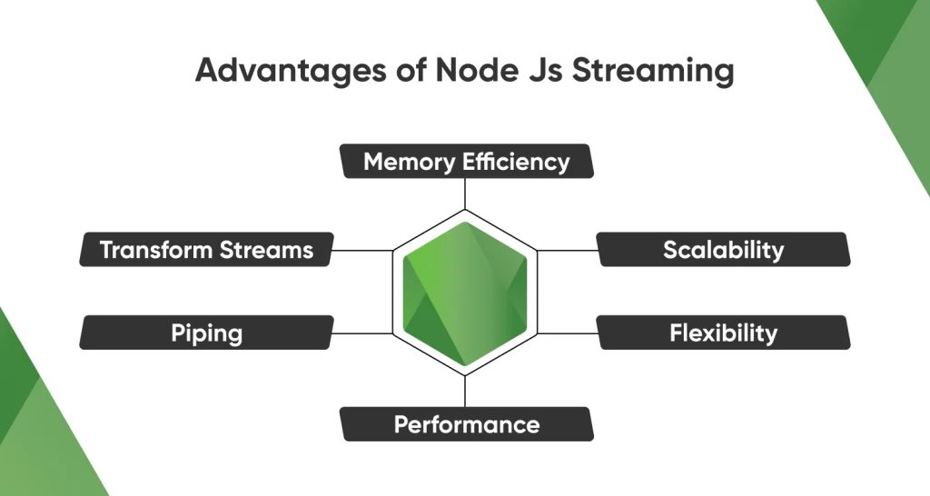

Slide 65
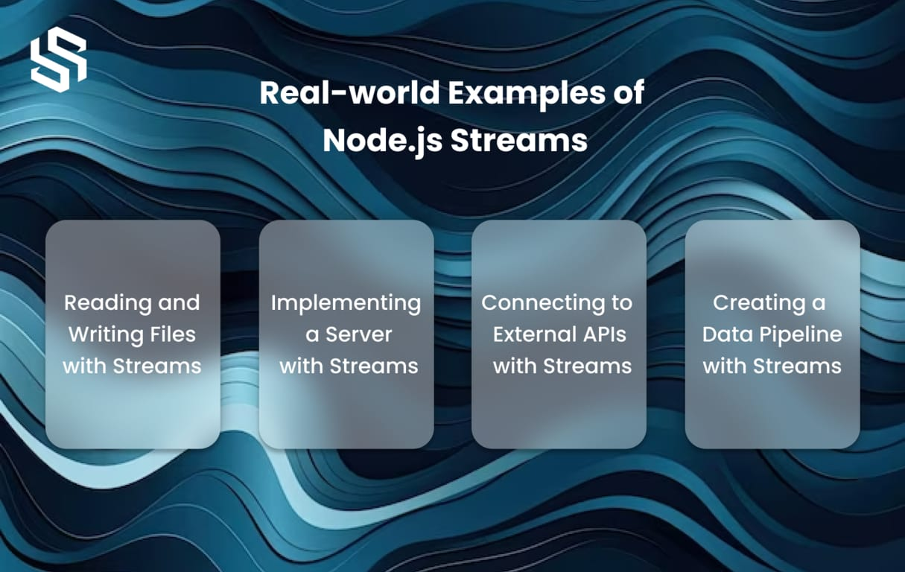

Slide 66
Syntax of reading a stream
When we use stream module
Require(‘stream’)
When we use fs module
Require(‘fs’)

Slide 67
ZLIB
The Zlib module provides a way of zip and unzip files.
The syntax for including the Zlib module in your application:
var zlib = require('zlib');

Slide 68
Compression:
zlib.gzip(): Compresses a buffer or string using gzip compression.
zlib.deflate(): Compresses a buffer or string using deflate compression.
zlib.deflateRaw(): Compresses a buffer or string using raw deflate compression.
zlib.brotliCompress(): Compresses a buffer or string using Brotli compression

Slide 69
Decompression:
zlib.gunzip(): Decompresses a gzip-compressed buffer or string.
zlib.inflate(): Decompresses a deflate-compressed buffer or string.
zlib.inflateRaw(): Decompresses a raw deflate-compressed buffer or string.
zlib.brotliDecompress(): Decompresses a Brotli-compressed buffer or string

Slide 70


Slide 71
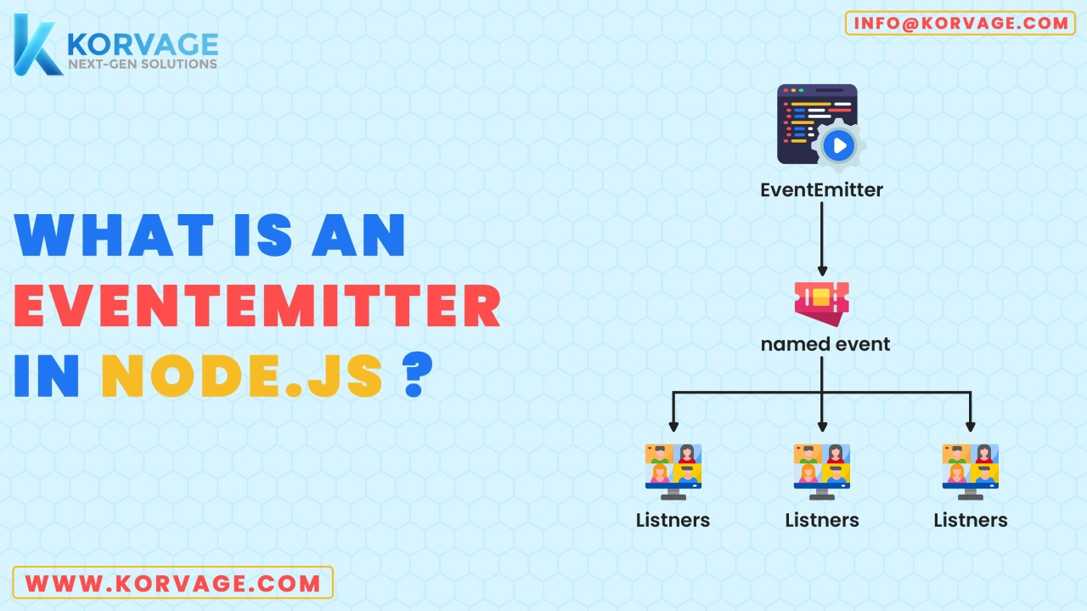

Slide 72
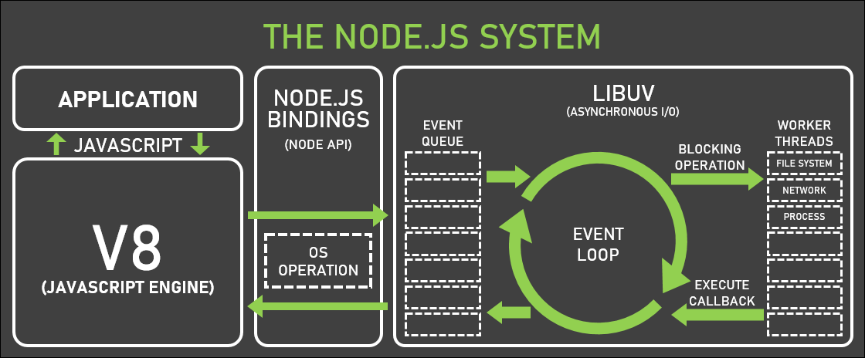

Slide 73
Each type of Stream is an EventEmitter instance and throws several events at different instance of times
For example:
data − This event is fired when there is data is available to read.
end − This event is fired when there is no more data to read.
error − This event is fired when there is any error receiving or writing data.
finish − This event is fired when all the data has been flushed to underlying system.

Slide 74
Event Emitter
Node.js uses an events module to create and handle custom events. The EventEmitter class can be used to create and handle custom event modules. Syntax:
const EventEmitter = require('events’);
All EventEmitters emit the event newListener when new listeners are added and removeListener when existing listeners are removed.

Slide 75


Slide 76
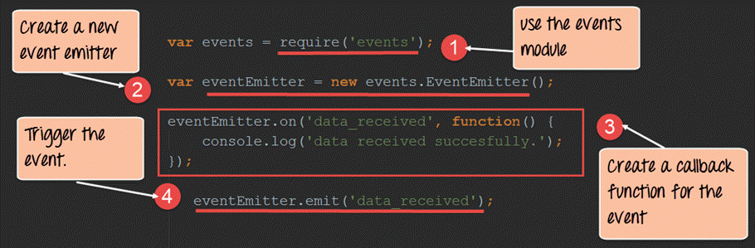

Slide 77
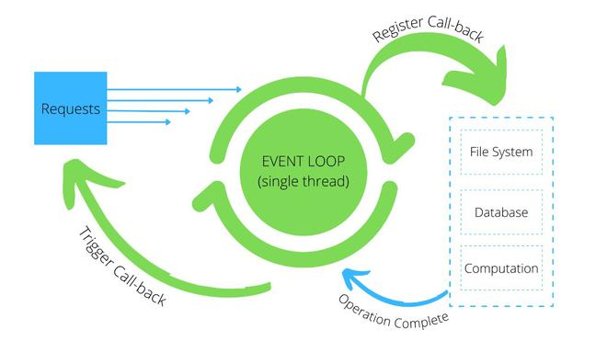
How event emitter works

Slide 78
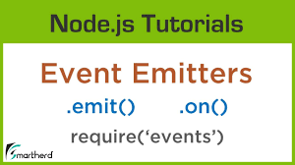

Slide 79
Listening events
Before emits any event, it must register functions(callbacks) to listen to the events.
eventEmitter.on(event,listener) and eventEmitter.addListener(event, listener) are pretty much similar

Slide 80
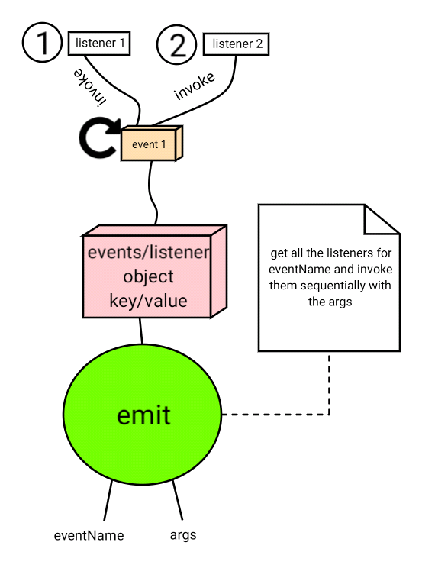
Emitting events
Syntax:
eventEmitter.emit(event, [arg1], [arg2], [...])

Slide 81
Removing Listener
The eventEmitter.removeListener() takes two argument event and listener, and removes that listener from the listeners array that is subscribed to that event.
While eventEmitter.removeAllListeners() removes all the listener from the array which are subscribed to the mentioned event.

Slide 82
Syntax
To remove single listner:
eventEmitter.removeListener(event, listener)
To remove all listners:
eventEmitter.removeAllListeners([event])

Slide 83
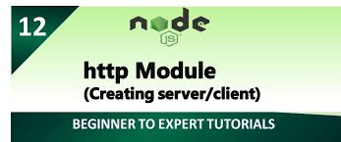

Slide 84
HTTP module
In Node.js, the http module is a core module that provides functionality for creating HTTP servers and clients
It allows you to make HTTP requests, handle incoming HTTP requests, and create HTTP servers
The HTTP module can create an HTTP server that listens to server ports and gives a response back to the client.

Slide 85
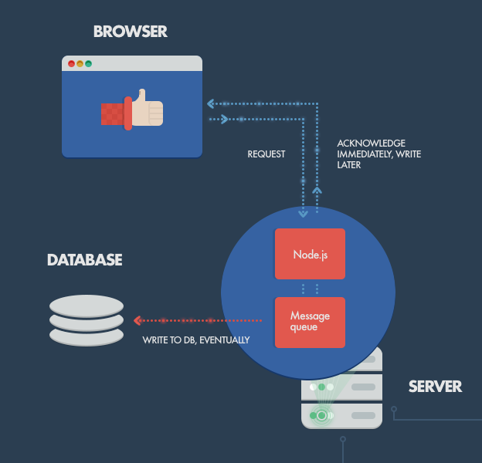

Slide 86
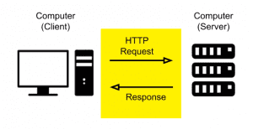

Slide 87
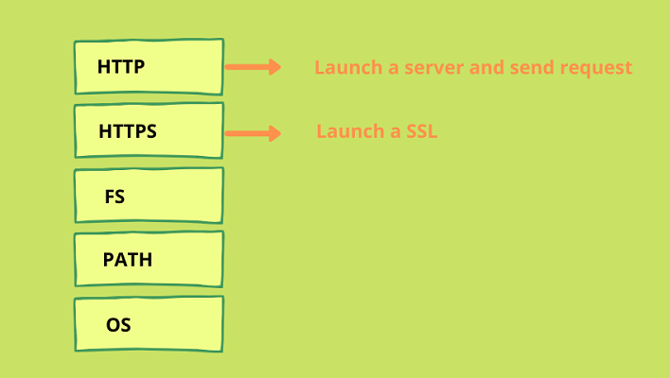

Slide 88
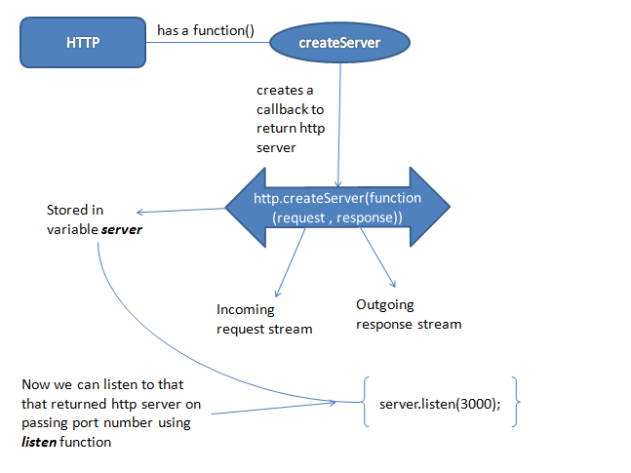
How an http server works actually

Slide 89
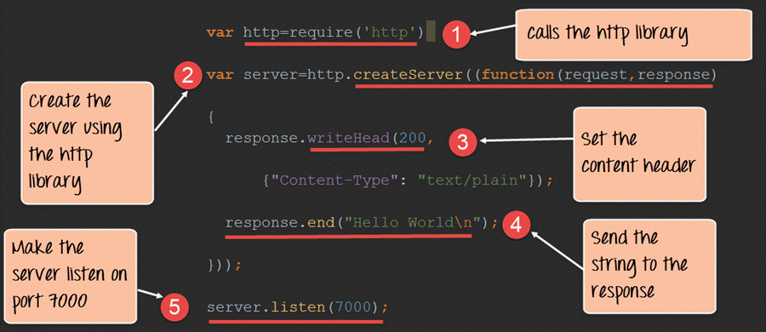

Slide 90
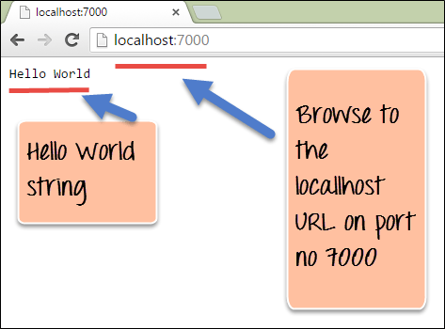

Slide 91
how things work…..
To use the HTTP server in the node, we need to require the HTTP module.
The HTTP module creates an HTTP server that listens to server ports and gives a response back to the client.
const http = require('http');

Slide 92
Creating HTTP server…
You can create an HTTP server using the http.createServer() method.
This method takes a callback function that will be invoked whenever a request is received by the server

Slide 93
const http = require('http');
const server = http.createServer((req, res) => {
res.writeHead(200, {'Content-Type': 'text/plain'});
res.end('Hello World\n');
});
server.listen(3000, () => {
console.log('Server running at http://localhost:3000/');
});

Slide 94


Slide 95
What is url
A URL string is a structured string composed of several meaningful components.
Url module is one of the core modules that comes with node.js, which is used to parse the URL and its other properties.
The Node.js URL Module is provided to perform operations with address URLs.
We can split a web address into manageable parts.
A URL string may carry information including the protocol such as https, the hostname, query string values, and more

Slide 96
Why we need URL module
The URL module splits up a web address into readable parts.
It allows you to work with URLs by providing methods for parsing URL strings into their component parts (such as hostname, path, query parameters, etc.), as well as methods for formatting and resolving URLs.

Slide 97

Parsing URLs
We use url.parse() method to parse a URL string

Slide 98


Slide 99
Formatting URLs
We use url.format() method to format a url.
const formattedUrl = url.format({
protocol: 'https:',
hostname: 'www.example.com',
pathname: '/path',
query: 'query=value'
});
console.log(formattedUrl);

Slide 100
Resolving URLs:
const resolvedUrl = url.resolve('https://www.example.com', '/path’);
console.log(resolvedUrl);

Slide 101
url.toString() Method
the url.toString() method is used to return the serialized URL. The returned value is equivalent to that of url.href and url.toJSON().
Syntax:
url.toString()

Slide 102
URL.toJSON() Method
The url.toJSON() method in the node.js URL module is used to return the serialized URL of the URL object
syntax
url.toJSON()

Slide 103
Query string
in Node.js, a query typically refers to a part of a URL that contains data to be passed to the server
When a client sends a GET request to a server, it can include a query string as part of the URL

Slide 104
Query string contd…..
A query string is a set of characters tacked onto the end of a URL.
the query string begins after the question mark (?) and can include one or more parameters. Each parameter is represented by a unique key-value pair or a set of two linked data items. An equals sign (=) separates each key and value. An ampersand (&) separates multiple parameters.

Slide 105
Here’s an example of a URL with a query string including three parameters.
https://www.tech.com/search?query=database+tools&star_rating=4&order=alphabetica

Slide 106
Why Are Query Strings Important
They pass information to the web server, telling it what content to deliver or action to take.
They also pass information to other applications, improving the user experience (UX) and satisfying other business objectives.
They are important from a marketing perspective, too — tracking website traffic, monitoring the search terms on your website, personalizing marketing campaigns, and more.

Slide 107
Difference Between Query and Path Parameters
URL | Query string
Positioned to the left of the question mark (?) | Positioned to the right of the question mark (?)
Can’t be omitted as it would change the URL path | Can be omitted since they aren’t part of the URL
Used to identify a specific resource or page | Used to sort and filter resources

Slide 108



Slide 109


Slide 110
Query string modules
The Query String module is used to provide utilities for parsing and formatting URL query strings. It can be used to convert query strings into JSON objects and vice-versa.
Requiring Module: You can include the module using the following code:
const querystring = require('querystring');

Slide 111


Slide 112
Understanding Request , Response and Server Objects
www is based on a request/response paradigm.
A Request class defines "an operation to be performed on a URL".
The request object is the main entry point for an application to issue a request to the Library - all operations on a URL must use a Request object.

Slide 113


Slide 114
The request object is application-independent in that both servers and clients use the same Request class.
Examples of requests passed to the Library are a client application issuing a GET request on an HTTP URL, or a server issuing a load on a local file URL.
The only difference is that the client gets the input from a user whereas the server gets the input via the network.

Slide 115
request
Every HTTP request contains three elements which are:- Request Line, Request Header, Body of Request(optional).

Slide 116


Slide 117
Request line:-
It specifies the method, which tells the server what to do with the information or resource.
It contains the URL of the request which is used to find the resource on the server.
It also specifies HTTP protocol version being used (Ex. HTTP/ 1.0 or HTTP/1.1)

Slide 118
Request Header:- It consists of 0 or more headers.
The headers are used to pass more information about the request so that using the request headers the server knows how to deal with the information the client is demanding.
I.e What should be the language of content to be displayed, what should be the content-type that client demands.

Slide 119
Request Body:-
This is an optional part of the HTTP request which is used to send additional data to the server.

Slide 120
HTTP Response
The response from the server with the target to provide the client with the desired resources is HTTP Response.

Slide 121


Slide 122
Status line:- HTTP/1.1 302 Found This is how the status line of the response header looks like. It contains the HTTP protocol version, status code, Reason phrase (known as status text).
Response Header:- There can be one or more response header lines and they are used to pass additional information to the client from the server.

Slide 123
Response Body:- The response body contains the resource demanded by the client. If the request is unsuccessful then the response body contains the reason for the error, it may also contain the steps to be done by the client to complete the request successfully.

Slide 124
Understanding Request , Response and Server Objects
Request and Response objects both are the callback function parameters and are used for Express and Node. You can get the request query, params, body, headers, and cookies. It can overwrite any value or anything there.
Express uses request and response object parameters of the callback function and is used for the Express applications. The request object represents the HTTP request and contains properties for the request query string, parameters, body, HTTP headers, etc.

Slide 125


Slide 126


Slide 127


Slide 128
List of Methods
basename()
This function allows you to retrieve the last portion of a specified path.
delimiter
It is a platform-specific property, it represents the delimiter (separator) used to separate the file paths in the environment variable named PATH of the current operating system.

Slide 129
dirname()
This method is used to retrieve the parent directory for a specified path.
extname()
Used to get the extension of the given file, based on the last occurrence of the (.) period character in the path

Slide 130
normalize()
It is used to normalize the given path
toNamespacedPath()
It returns an equivalent namespace-prefixed path for the given path.

Slide 131


Slide 132


